Slide 1



Infrastructure as Code Webinar
+
=
< />

Slide 2

Agenda
Infrastructure as Code Overview
F5 Automation Toolchain
Infrastructure as Code with Terraform and F5

Slide 3
Infrastructure as Code Overview

Slide 4



Key Market Trends
Execution at the speed of software
Changing customer behavior and new expectations
Rapidly changing business models
Agility, DevOps, NFV, SDN, new services platforms
Fast changing business needs
Everything on demand
New services with a press of a button – or auto deployed
Cloud services, microservices, virtualization, programmable networks
New ecosystems and value chains
All of this requires successful, flexible automation.
Notes:
The world of application delivery is changing. Application teams and the network teams they rely on are expected to deliver applications faster than ever before.
This has lead to the rise of the idea of the network as software – from this has come the concepts of Software defined networking, network function virtualization and methodologies such as DevOps, SuperNetOps, and Agile development.
Concurrent with this are changing customer behaviors based on the expectation that networking can be deployed on demand, automatically.
All this is being driven by rapidly changing business models based on cloud services and eco systems of often open source solutions.

Slide 5
What’s Missing?
DevOps Continuous Integration Cycle
Ops
Notes:
You have seen a thousand variants on this image – the stages of DevOps. But something important is missing from this process. What’s missing, of course, is the network. Deploying and securing your application, monitoring and optimizing app performance, and ensuring that the correct security policies are in place. The “Ops” in DevOps needs a bit more attention – so let’s take a deeper look

Slide 6

Why Infrastructure as Code
Cost Reduction
Speed Increase
Risk Reduction
Reduce cost of deployment and maintenance
Focus engineers on other higher-level tasks
Reduce potential outages
Deploy apps and needed infrastructure on-demand
Mimic Cloud Provider capabilities
Reduce human errors
Build inherent security
Can be integrated into same CI/CD system developers use today
https://en.wikipedia.org/wiki/Infrastructure_as_code
Notes:
The world of application delivery is changing. Application teams and the network teams they rely on are expected to deliver applications faster than ever before.
This has lead to the rise of the idea of the network as software – from this has come the concepts of Software defined networking, network function virtualization and methodologies such as DevOps, SuperNetOps, and Agile development.
Concurrent with this are changing customer behaviors based on the expectation that networking can be deployed on demand, automatically.
All this is being driven by rapidly changing business models based on cloud services and eco systems of often open source solutions.

Slide 7
Two Main Approaches
VS
IMPERATIVE
DECLARATIVE
Tell the system HOW to do something – every step of the way
Tell the system WHAT you want, and let it figure out HOW to do it
Declarative API – you define the desired end-state – it fills in the details on “how to get there”

Slide 8
Declarative Benefits
Benefits
Minimizes need for TMOS domain expertise
Speeds dev time
Requires few API calls
Minimizes deployment errors
Eases integration int A&O systems
Repeatable and enforces policy compliance
DECLARATIVE
Tell the system WHAT you want, and let it figure out HOW to do it
Declarative API – replace numerous API calls with one declarative API
Notes:
The declarative approach allows you to specify what you want to happen – say load balance and apply WAF to an app – and it figures out how to do it.
So you don’t need to be an F5 expert
It speeds the deployment process
It’s simple and requires few API calls
It is repeatable and minimizes errors
It makes it easy to integrate the deployment of F5 services into a broader orchestration system

Slide 9
Methods
VS
Push
Pull
Configuration is pushed to the infrastructure
Infrastructure has to pull configurations from master node
There is no “right” method, the choice is typically based on the tool you choose.

Slide 10
Tools
VS
Ansible
Terraform
Great configuration management tool with a powerful template engine
Orchestration tool with a powerful state management
I would argue you can and should use both together! Check out the Linux Academy blog for more info.
https://linuxacademy.com/blog/devops/ansible-vs-terraform-fight/

Slide 11
F5 Automation Toolchain

Slide 12
F5 Automation Toolchain
The Toolchain
A set of free tools for automating deployment and configuration of F5 devices and services through declarative APIs.
Use for automation and integration of F5 solutions into automation and orchestration systems.
F5 Automation
Toolchain
Notes:
To support these trends, F5 offers the F5 Automation Toolchain – a group of free, open sourced, inter-related tools designed to allow you to automate the delivery of security and network application services. The toolchain includes:

Slide 13
F5 Automation Toolchain
Cloud Templates
F5 Cloud Templates
Easily deploy F5 fully configured, operational F5 BIG-IP VEs into public and private clouds.
Leverage each cloud’s native services to support a wide variety of BIG-IP VE use cases.
F5 Automation
Toolchain
Notes:
F5’s cloud templates which help you quickly and consistently deploy and configure F5 services across multiple public cloud environments. The templates can be integrated with 3rd party automation tools such as Chef, Puppet, and Ansible to simplify the creation and operation of autonomous cloud architectures.
All templates are available from the F5 GitHub Repository free of charge. In addition, templates for AWS, Azure and Google Cloud have been integrated into their respective cloud marketplaces.

Slide 14
F5 Automation Toolchain
Cloud Templates
F5 Declarative Onboarding
Declarative Onboarding
Provisions initial configuration of virtual BIG-IP devices through a declarative API.
F5 Automation
Toolchain
Notes:
F5 Declarative Onboarding which uses a declarative model to initially configure BIG-IP devices. This includes system settings such as licensing and provisioning, network settings such as VLANs and Self IP addresses, as well as clustering settings if you are using more than one BIG-IP system.

Slide 15
F5 Automation Toolchain
Cloud Templates
F5 Application Services 3 Extension
Declarative Onboarding
Configure F5 modules using declarative APIs. Runs on TMOS, as a container, or in BIG-IQ 6.1+
F5 Automation
Toolchain
AS3
Notes:
Following the Declarative Onboarding tool is the F5 Application Services 3 Extension. AS3 allows you to manage application-specific configurations on BIG-IP systems. AS3 uses a declarative model, meaning you provide a simple JSON declaration rather than a detailed set of imperative commands.

Slide 16
F5 Automation Toolchain
Cloud Templates
F5 API Services Gateway
Runs F5 & Customer BIG-IP API Extensions in a container or VM platform.
Declarative Onboarding
F5 Automation
Toolchain
AS3
API Services Gateway
Notes:
The F5 API Services Gateway (aka the “LX Container”) is a TMOS-independent Docker container which runs F5’s iControl LX framework. It is intended to be an off-box iControl LX vehicle in which customers can run their own custom iControl LX extensions, in any containerized environment, independent of TMOS & BIG-IP.
It is worth noting that as far as I know, none of our competitors offers this capability in a Docker container, much less on their hardware or virtual platforms.

Slide 17
F5 Automation Toolchain
Cloud Templates
F5 Telemetry Streaming
Stream BIG-IP telemetry for analytics and automation.
Telemetry Streaming is an BIG-IP API extension that will send client/server stats from the BIG-IP in Kafka format.
Declarative Onboarding
F5 Automation
Toolchain
AS3
API Services Gateway
Telemetry Streaming
Notes:
Telemetry Streaming (TS) is an iControl LX Extension that enables you to aggregate, normalize, and forward statistics and events from a BIG-IP to a consuming application. This application can be another link in the toolchain or a 3rd party tool such as:
Splunk (additional testing required)
Azure Log Analytics
AWS CloudWatch
AWS S3
Graphite

Slide 18
IaC with Terraform and F5

Slide 19
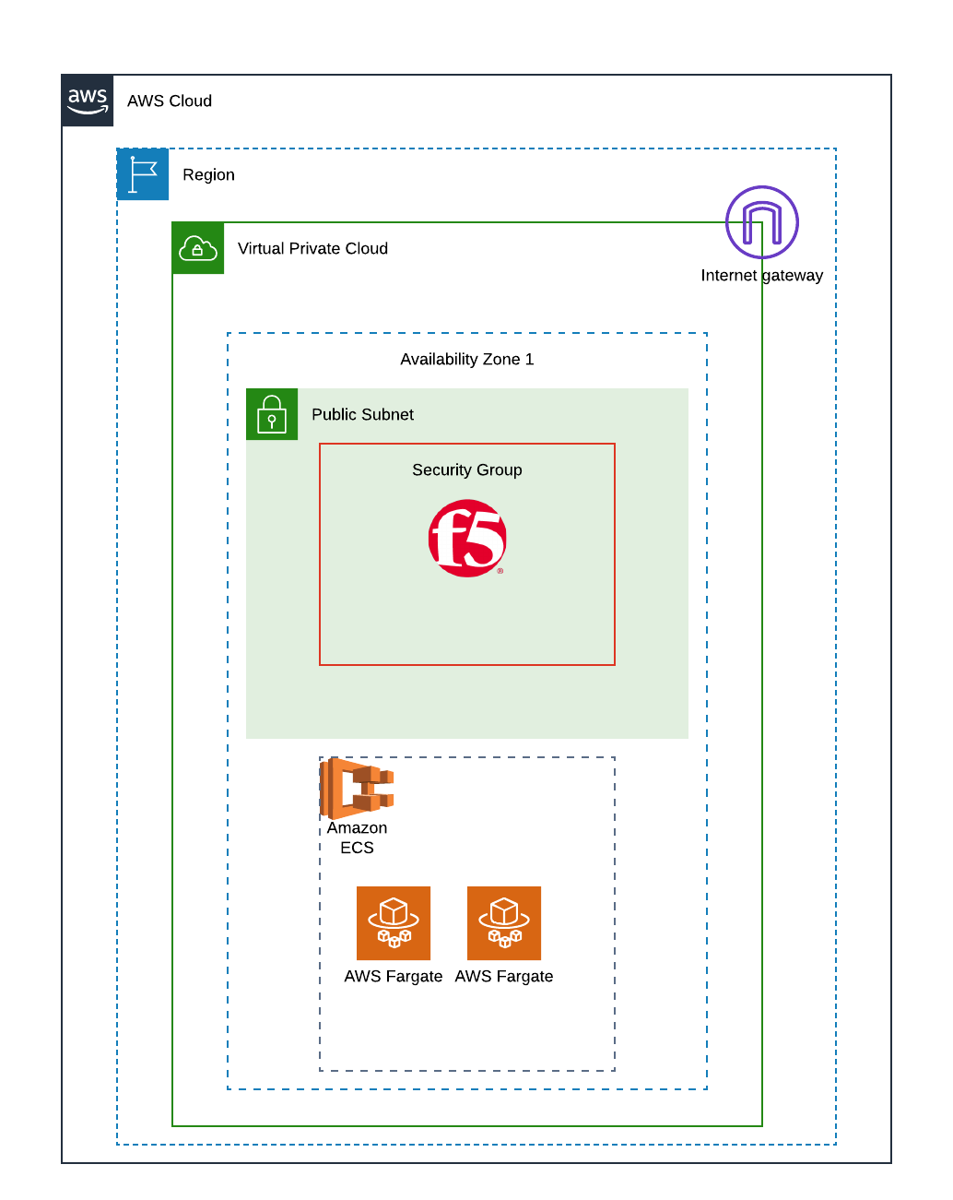
Design
In this example we’ll deploy:
Single AZ deployment in us-east-2
Security group to only allow management from your public IP
Security group to allow http and https traffic from anywhere
Single BIG-IP instance
Single NIC
25 Mbps
Marketplace PAYG licensing
ECS Cluster
2 Fargate instances running demo app in docker container

Slide 20
Terraform Basics
Overview
Ability to define desired infrastructure end state and manage the planning and deployment of said end state repeatably in multiple environments
Key Benefits:
Easily manage infrastructure using code repositories
Ability to see what changes will be made using plan method
Powerful state management
Ability to “taint” certain components in your infrastructure without re-deploying everything
Maintained by Hashicorp
Declarative approach
Push method
Written in Go

Slide 21
Terraform Basics
Commands and Modules
This example uses Terraform modules to help break up the individual components for ease of deployment and reuse
BIG-IP
Compute (ECS)
IAM
Networking
We define output files so we can pass variables between the various module
For a great tutorial check out Linux Academy’s Managing Applications and Infrastructure with Terraform Course (7 Day Trial)
terraform init
terraform plan
terraform apply
terraform taint
terraform destroy

Slide 22
Requirements
System Requirements:
Terraform 0.11.13 or higher
BIG-IP 13.1 or higher
Install and configure the AWS CLI
https://docs.aws.amazon.com/cli/latest/userguide/cli-chap-install.html
Tips:
If you do not want to use the AWS CLI then you’ll need to define your access and secret key information in the AWS Provider
The AWS CLI is used to find the private IP address of the ECS instances since this is not returned in the AWS API payload upon creation

Slide 23
Demo

Slide 24
Q&A

Slide 25
Resources
Session 1 Recording – BIG-IP Automation with Ansible https://www.youtube.com/watch?v=AodZltew9wk
Session 2 Code and Slides – https://github.com/codygreen/Automation_Webinar
Session 3 Registration Link (also in follow-up email) – https://f5networks.zoom.us/webinar/register/9415537400250/WN_dVwU_fVTTQeCGH6QwrR3cA

